Slide 1
National Record Locator
Presented by
Dave Jarvis, Karen Akehurst and Phil Radford

Slide 2
Agenda
Introductions
What does it do?
How does it work? (Phase 1 – contact details)
How does it work? (Phase 2 – document retrieval)
IG Overview
What Next?
Onboarding

Slide 3
Introductions

Slide 4
The Vision:
The National Record Locator (NRL) is a national index of pointers to patient records. It enables an authorised clinician, care worker and/or administrator, in any health or care setting, to access a patient’s information to support that patient’s direct care.
The Principles:
The NRL integrates patient record access across the NHS and Social Care without dictating where those records might be stored, thus realising a level of national interoperability across the service which has previously been unachievable
NRL is NOT a central data store for patient records
It is an index that provides the location of records, the technical means to retrieve them, underpinned by an IG framework to safely support sharing on a national scale
Notes:
NRL has huge potential for a wide number of use cases and stakeholders.
However, the strategy is one of iterative development.
Each new release offers more functionality and benefit to a wider range of users.

Slide 5


NRL enables cross border record sharing on a national scale
Lancashire Care
NRL is connecting local and regional sharing initiatives such as LHCRs, Shared Care Records, software supplier associations, and individual trusts, giving them a national presence
MENTAL HEALTH CRISIS PLAN
Patient lives in Preston
London Ambulance
To scale this up nationally, local data sharing agreements are insufficient. More on this later….
Receive 999 call
Treat patient
Retrieve plan from Lancashire Care via the NRL
Patient travels to London
Requires emergency care and calls 999

Slide 6





NRL Overview – Phase 1 (contact details)
Patient record
NRL
Search NRL
3
Add Pointer
2
4
View Pointer
NRL PROVIDER
NRL CONSUMER
PHASE 1
Publish
Contact
Details
1
Request URL
5
6
View contact details
WWW

Slide 7
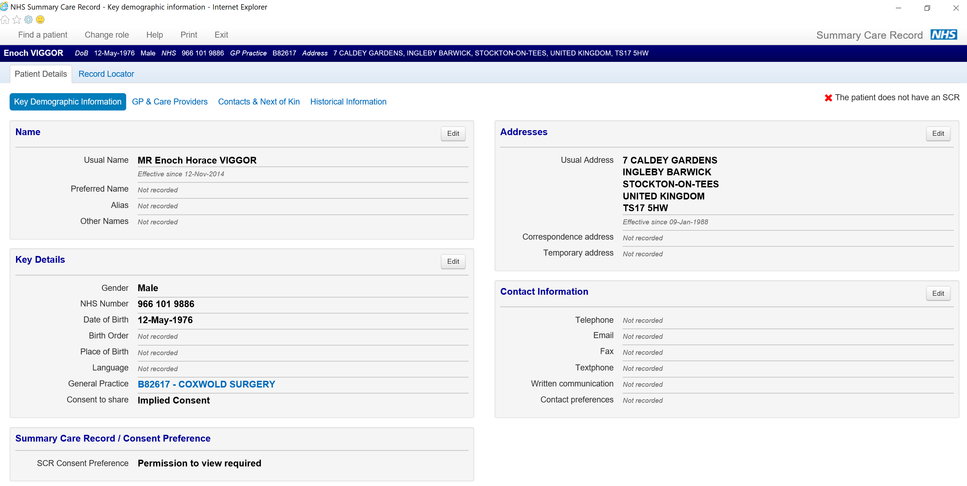
SCRa (Summary Care Record Application)

Slide 8
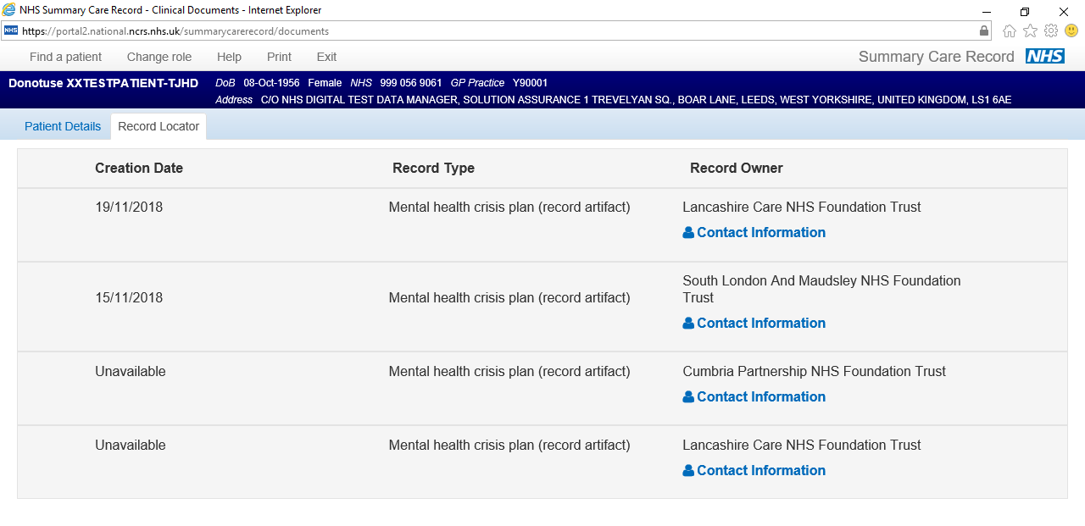
SCRa (Summary Care Record Application)

Slide 9
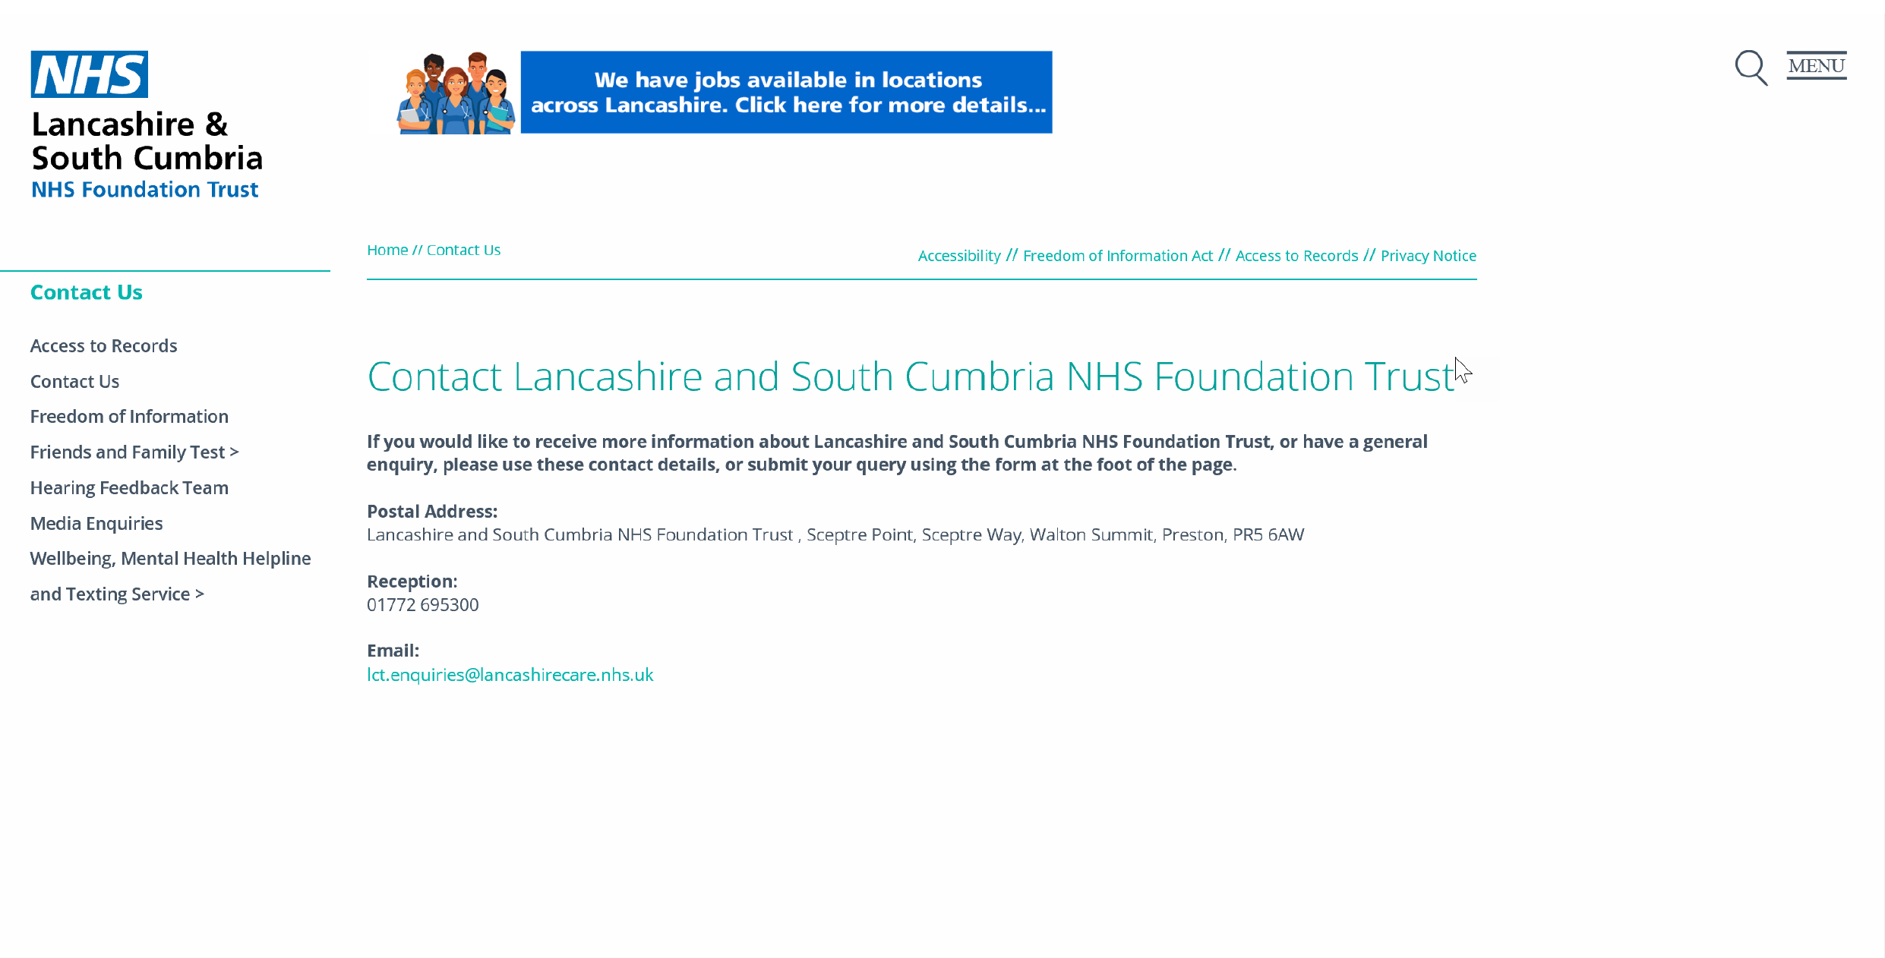
Crisis Team contact details

Slide 10
National Record Locator Phase 1 - Sites and Volumes

Slide 11
NRL Phase 1 (Live November 2018)
NRL index capability in use across 4 geographical regions (North West, North East, London, Yorkshire)
Over 85,000 Mental Health (MH) crisis plan pointers uploaded since 2018, with 12,000 searches on SCRa with 2,127 pointers viewed and 80 contact details consumed
5 MH Trusts and 2 Shared Care Records providing pointers with 4 Ambulance Trusts consuming

Slide 12
“Having access to the contact details for a patient and knowing a care plan exists and who I can speak to for more information has saved me time when triaging patients”
Jason Larkin
Mental Health Nurse North West Ambulance Service
Notes:
Quote from a mental health nurse from NWAS.

Slide 13


NRL Overview – Phase 2
Patient record
NRL
Search NRL
3
9
Add Pointer
Integration with NHS Identity and Mobile SCRa
2
4
View Pointer
NRL PROVIDER
NRL CONSUMER
Request record
Request record
7
SSP
7
8
8
Publish
Contact
Details
Return record
Retrieve record
1
Request URL
5
6
View contact details
WWW
Notes:
The SSP authorises and authenticates systems that use the NRL. This is restricted to only those who have completed the full NHS Digital Onboarding process (technical conformance, formal agreements – SCAL (Supplier Conformance and Assessment List), Connection Agreement, End User Organisation Declaration).
Consumer Access is controlled by Smartcard only (or equivalent i.e. NHS Identity). The RA manager for each consuming organisation is therefore the authoriser of each user. NHS Identity is the authenticator for each a user

Slide 14
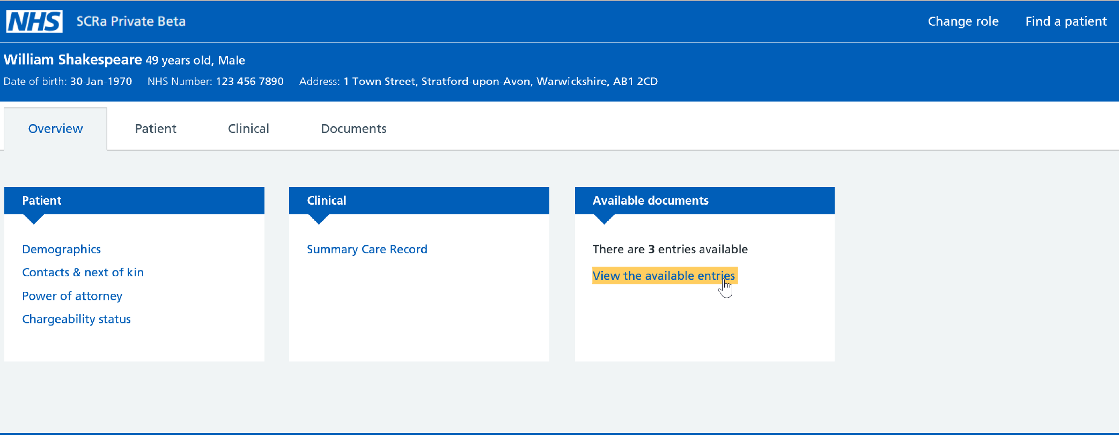
New SCRa view

Slide 15
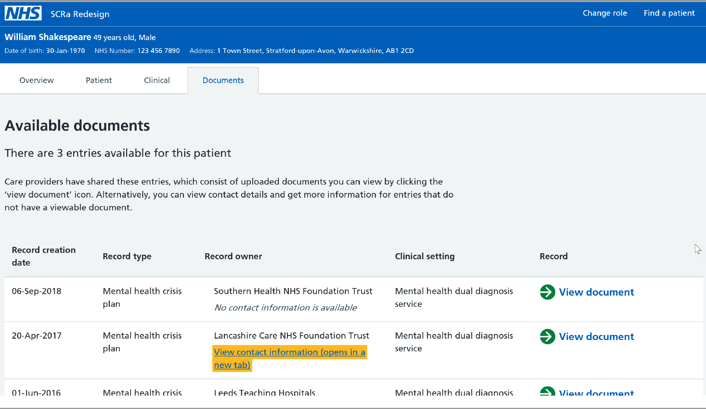
SCRa Pointer list view

Slide 16
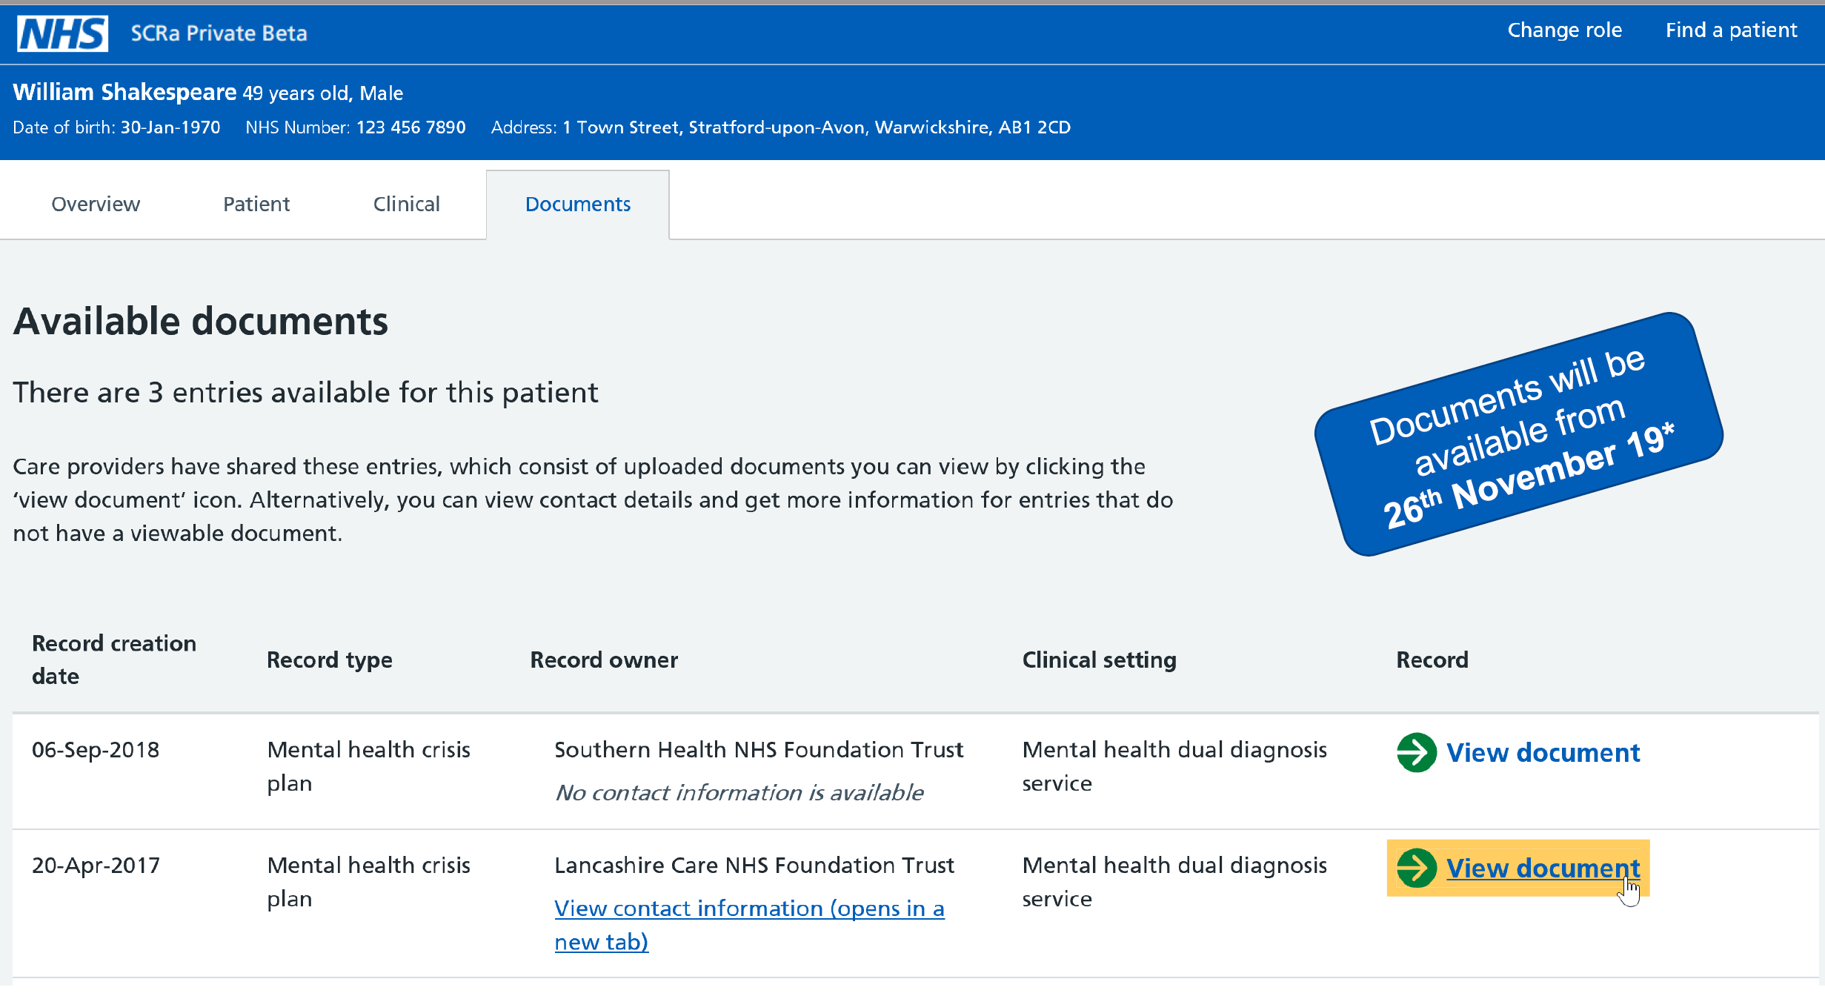
View document link
Record Retrieval LIVE December 2019

Slide 17
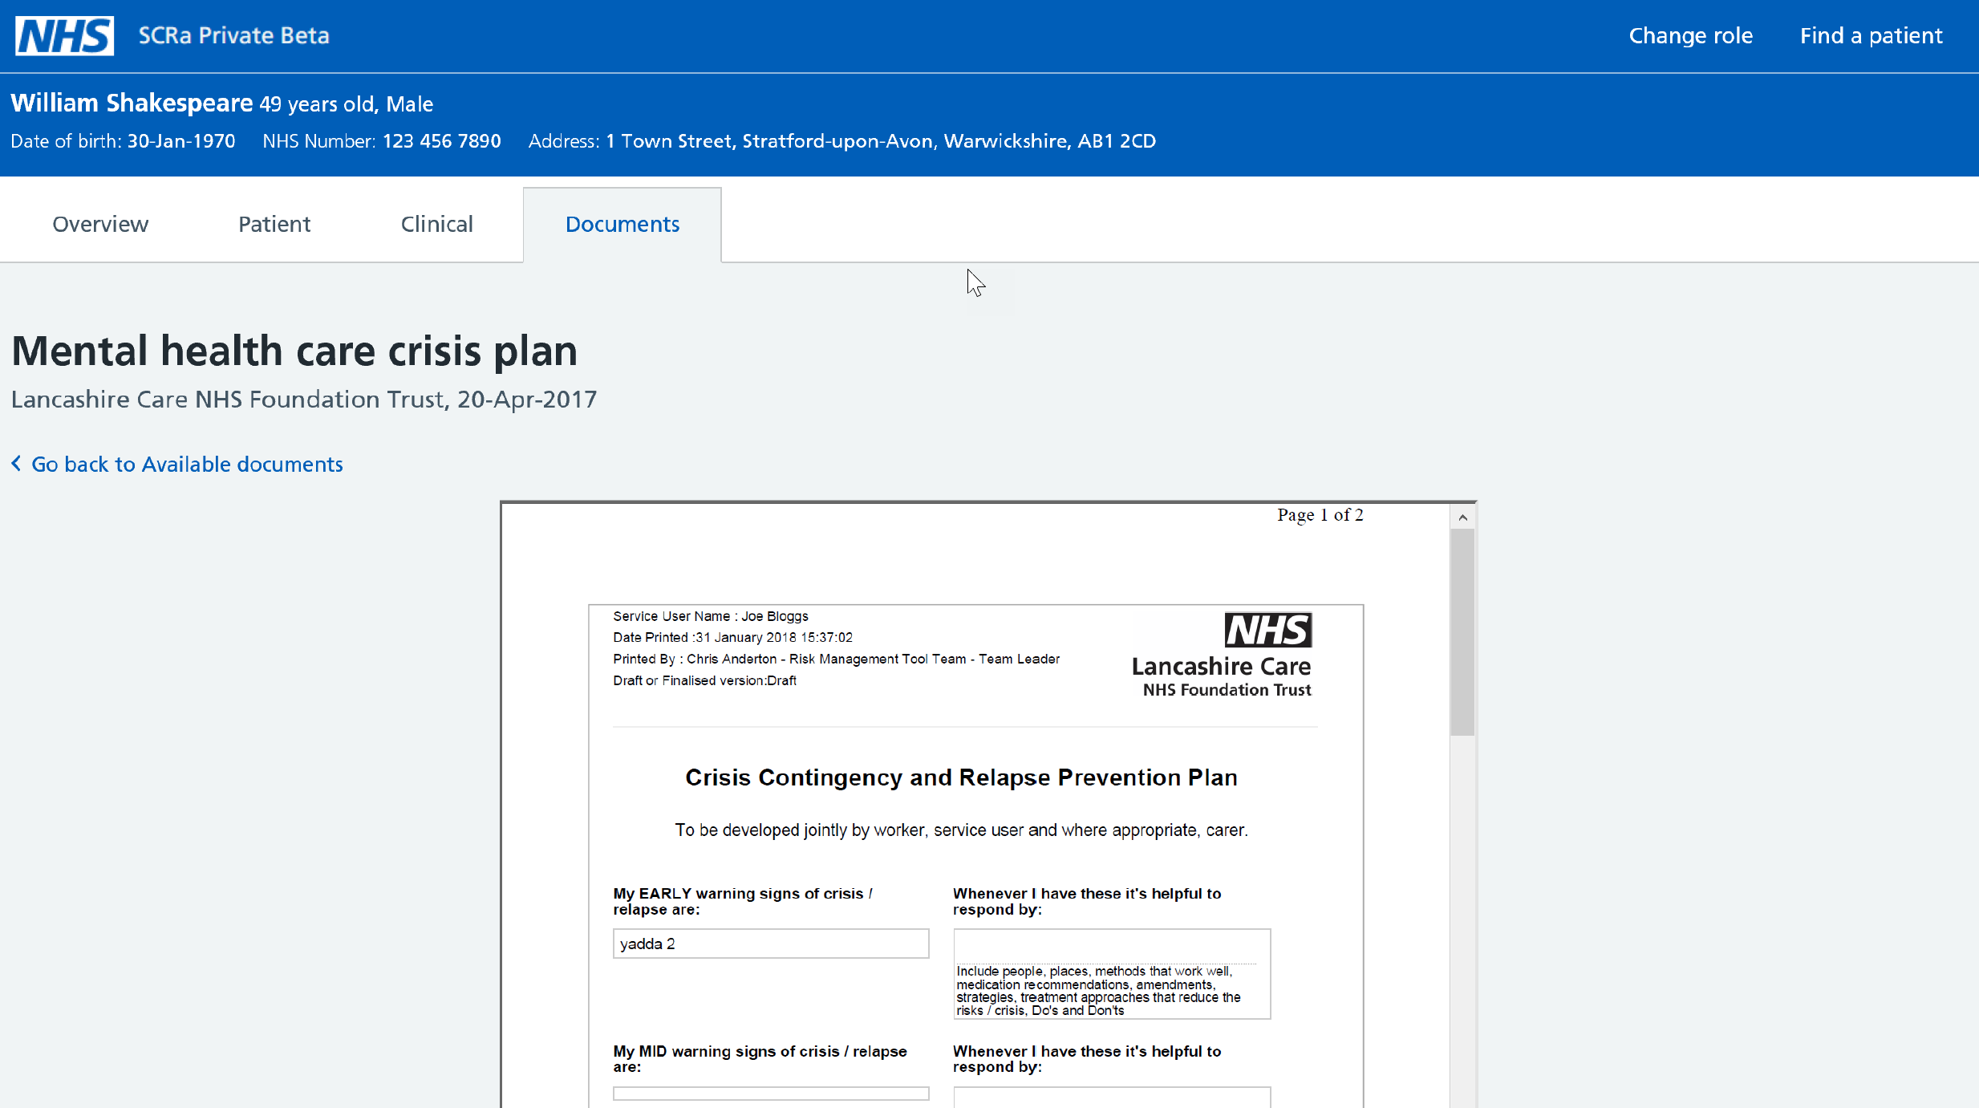
View of document
Notes:
NRL technically enabled record retrieval in December 2019, just one year after NRL went live with pointers to crisis teams contact details for a patient.
South London and Maudsley NHS Foundation Trust was the first mental health trust to enable the retrieval of their records on NRL (National Record Locator) from 20th February 2020 and despite not being in the same locality on the 1st March 2020, Sean Te Haara, a London Ambulance Advanced Paramedic Practitioner, was the first to use NRL to retrieve a mental health crisis plan.
This enabled him to deliver better care to the patient at the scene. The patient’s crisis plan was made available to him on his iPad by leveraging the functionality provided by the NRL in conjunction with new SCRa (Summary Care Record Application) and the NHS Identity Service to deliver a secure and mobile solution on iPads in the North West London region. This is the first example whereby three integrating care programmes have combined to deliver benefit directly to frontline clinicians and assist in delivering better care to patients, based on their physical and mental health.

Slide 18
NRL Stakeholders – Connected, In-progress (onboarding) and engaged

Slide 19
NRL Phase 2 (Live December 2019)
Updated pointer model aligned with IHE standards to accommodate additional use cases and LHCR integration
Record Retrieval (via Spine Security Proxy integration) – enabling retrieval of Mental Health Crisis Plans (PDF)
Available on Mobile SCRa, integrated with NHS Identity

Slide 20
“The patient denied having any MH plan or diagnosis however, this was proven to be false upon viewing the SCRa which made available his mental health crisis plan via NRL. This reassured me that this depressive episode was known and strengthened my thoughts that his Mental Health would need to be managed in addition to his constipation. With this information the GP was notified to raise various social issues the patient was experiencing, with the recommendation that his MH team/family may need to be involved to aid his recovery.”
Sean Te Haara Advanced Paramedic Practitioner London Ambulance
Notes:
This case alone shows the benefits being achieved by NRL, the patient received care based on their specific needs, was not conveyed to hospital and the paramedic was able to make informed decisions based on the information available to him.

Slide 21
IG Overview

Slide 22
IG Principles
Direct care
Information: To Share Or Not To Share? The Information Governance Review
Lawful basis
Typically this will be 6(1)(e) ‘…necessary for the performance of a task carried out in the public interest or in the exercise of official authority…’
Legitimate relationship must exist
Consumers to manage locally. Must be able to prove.
Must have IG roles in place to support NRL
Caldicott Guardian, Data Protection Officer, Privacy Officer
Notes:
IG Principles
For Direct Care
Lawful basis
A legitimate relationship must exist to access records and full auditing is required from a consumer and provider side.
Must have IG Roles

Slide 23
NRL legal basis for sharing
Article 6(1)(e) ‘…necessary for the performance of a task carried out in the public interest or in the exercise of official authority…’
Article 9(2)(h) ‘…medical diagnosis, the provision of health or social care or treatment or the management of health or social care systems…’
Notes:
Legal basis for accessing records as set out in GDPR. Currently NRL is only being used by ambulance services but as it moves forward and expands there will be other consumers.

Slide 24
Existing NRL access model
NRL
NRL Providers
NRL Consumers
NRL Provider makes record available on NRL without restriction
All records available to all NRL Consumers subject to other access controls

Slide 25
Existing NRL access model: data flows

Slide 26
Proposed Access Model
NRL Consumer A
NRL
NRL Providers
Organisational
Restriction
NRL Consumer B
NRL Provider makes record available on NRL
Records available to NRL Consumers based on their organisation type

Slide 27
Other Existing Controls
User Access
Authentication: Smartcards / NHS Identity
Authorisation: NHS Digital defined RBAC
Professional Responsibilities
Professional code of conduct
Maintaining confidentiality
Organisational Responsibilities
Audit
Disciplinary measures
Monitoring
Notes:
User access: as per NRL Business Requirements
Professional responsibilities: if in breach, individual is at risk of disciplinary measures, professional de-registration and legal proceedings.
Organisational responsibilities: as signed up to in the onboarding documentation

Slide 28



Authentication – Smartcards & NHS Identity
Smartcard / NHS Identity
System auth.
NRL
Consumer
Pointer
NRL / SSP
Pointer
NRL
Provider
Record
Smartcard / NHS Identity
Notes:
User access: as per NRL Business Requirements
Professional responsibilities: if in breach, individual is at risk of disciplinary measures, professional de-registration and legal proceedings.
Organisational responsibilities: as signed up to in the onboarding documentation

Slide 29
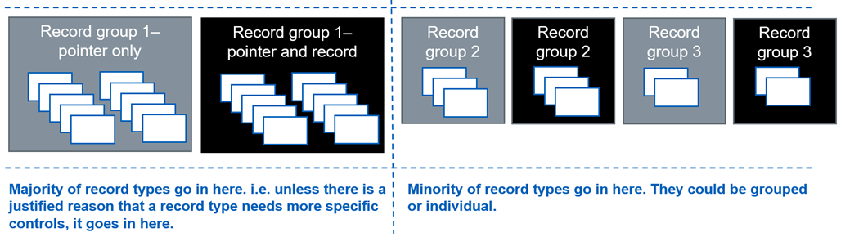
Authorisation – RBAC Model
Record Group | Record Types Contained | Access Level | RBAC Code
Record Group 1 | Mental health crisis plan | Pointer only access | B0268
 |  | Pointer and record access | B0269
Notes:
User access: as per NRL Business Requirements
Professional responsibilities: if in breach, individual is at risk of disciplinary measures, professional de-registration and legal proceedings.
Organisational responsibilities: as signed up to in the onboarding documentation

Slide 30
Audit Requirements
Central NRL audit log
All requests
User, Org & System details
Consumer audit log
Get & Read requests
User, Org & System details
Provider audit log
Post, Patch, Get & Delete requests
NHS Number
Response outcome and body
NHS number
User, Org & System details
NHS number
Response outcome and body
Consumer audit log
Requestor details
SSP audit log
Trace ID
Provider audit log
Requestor details
Record version
Trace ID
Record URL
NHS Number
Pointer ID
Trace ID
Requestor details
Response outcome
No clinical data
Request details
Pointer
Record
Retention periods
As per NHS Digital’s specified requirements
“…APPLICATION DATA will be kept for the life of the patient, plus an additional 30 yrs..”
Notes:
User access: as per NRL Business Requirements
Professional responsibilities: if in breach, individual is at risk of disciplinary measures, professional de-registration and legal proceedings.
Organisational responsibilities: as signed up to in the onboarding documentation

Slide 31
What Next?

Slide 32
Upcoming Use Cases
Direct integration for Consumers enabling access NRL without using the SCRa
Integration with LHCRs
Transition to Live Services
Expand supported record types
Care Plans
Healthy Child Record
Maternity Records

Slide 33
“Access to a well populated care plan is the holy grail of information for a paramedic. I’m really excited by care plans, because it tells the story of the patient and the answers to questions in an easy to read format”
Stuart Crichton
CCIO & Consultant Paramedic London Ambulance Service
Notes:
We are live with Ambulance Trusts and Mental Health Trusts currently and are onboarding EoL plans via Caspa, Graphnet and Coordinate My Care.

Slide 34

As taken from the Long Term Plan:
“Ensure that clinicians can access and interact with patient records and care plans wherever they are.”
“In 2020/21, people will have access to their care plan and communications from their care professionals via the NHS App; the care plan will move to the individual’s LHCR across the country over the next five years.”
Notes:
The sharing of care plans has been set out in the long term plan. We are working with LHCRs and non-LHCR areas to share these care plans. We are working with Graphnet, CASPA, Coordinate My Care and others to add pointers to care plans.

Slide 35
Onboarding

Slide 36
Onboarding Process
Review onboarding documentation
Development against online reference implementation
Local testing using TKW
Testing in the NHS Digital path-to-live environments
Complete the Supplier Conformance Assessment List (SCAL)
Sign connection agreements and the end user declaration
LIVE pipe-cleaning
Further detail is included in the NRL onboarding guide.

Slide 37
Prerequisites
A valid ODS code
Verification of NHS numbers via any of the following mechanisms:
Full PDS Spine compliant system
Spine Mini Service PDS (SMSP)
Demographics Batch Service (DBS) (NRL Providers Only)
N3 or HSCN connection
Appropriate authentication method for accessing data (if Consuming from NRL/NEMS)
Completion of DSPT (Data Security Protection Toolkit) within the last 12 months
Clinical Safety Officer to undertake a Clinical Safety Assessment

Slide 38
Questions?

Slide 39
Contact us:
NRLS@nhs.net

